Slide 1

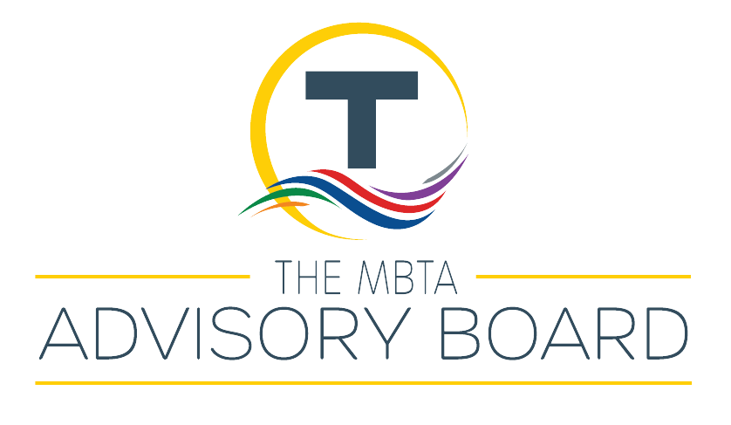
Comparative Fiscal Study of US Public Transit Agencies: Introduction
MBTA Advisory Board & Economics of the Public Sector at Boston University
Sept 9, 2025

Slide 2
The Massachusetts Bay Transportation Authority
Public agency responsible for operating transportation services in Greater Boston, oldest subway in the U.S.
Operates subway, light-rail, commuter rail, bus, ferry, para-transit
Daily ridership of around 800,000
Annual fare revenue: $403 million
Operating budget: $3 billion
Capital budget: $9 billion
How is the MBTA funded?

Slide 3
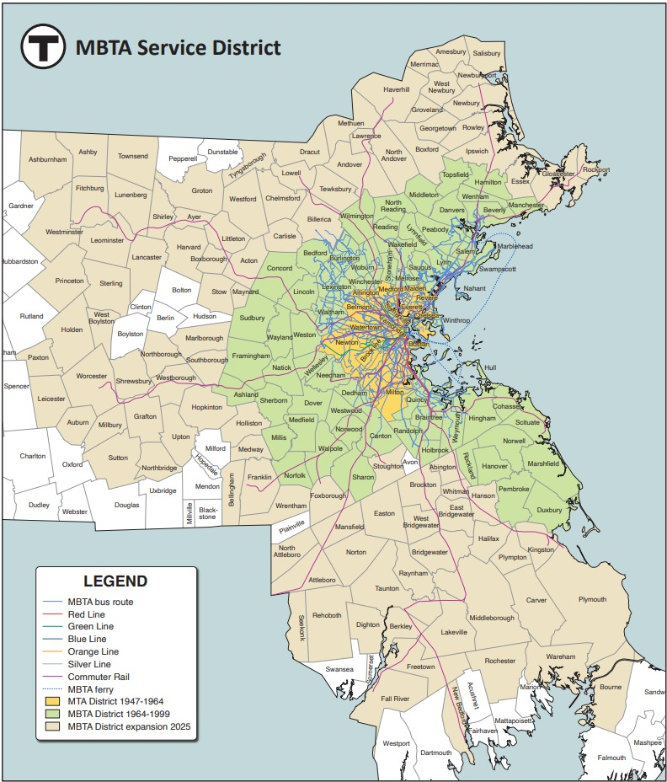
MBTA Advisory Board
Provides independent, public oversight of the MBTA on behalf of 178 municipalities in the service district
Conducts oversight of MBTA capital and operating budgets
Members are the Mayor, Select Board Chair, or other CEO of each city/town
Collectively paying the MBTA $200 million in assessments
Appoints 1 member of 9-person MBTA Board of Directors
Est. by MA State Legislature in 1964

Slide 4
Why fund public transportation?
Access to educational, medical, housing, cultural, and other opportunities
Economic benefits
Fewer drivers on the road
Less air pollution and greenhouse gas emissions from congestion

Slide 5
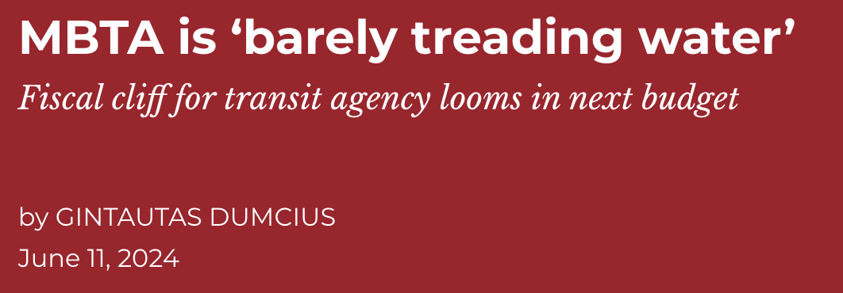
The MBTA's fiscal outlook
In 2024, the MBTA projected a $700 million operating deficit for FY2026
The MBTA has been in structural deficit since 2001
In June 2024, the MBTA Advisory Board reported to the MBTA Board of Directors:
"The service cuts required to close to $696 million deficit in 13 months are simply impossible to propose and still be considered a public transportation provider. To prevent these death-spiral-inducing actions, the MBTA Board urgently needs to begin discussions of financial restructuring to be able to plan for the foreseeable crisis ahead."

Slide 6
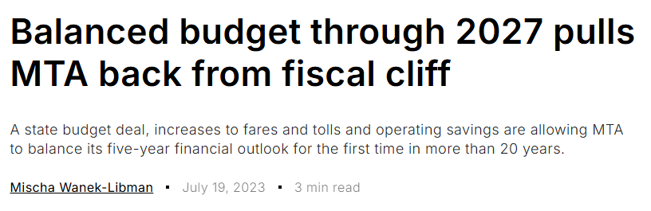
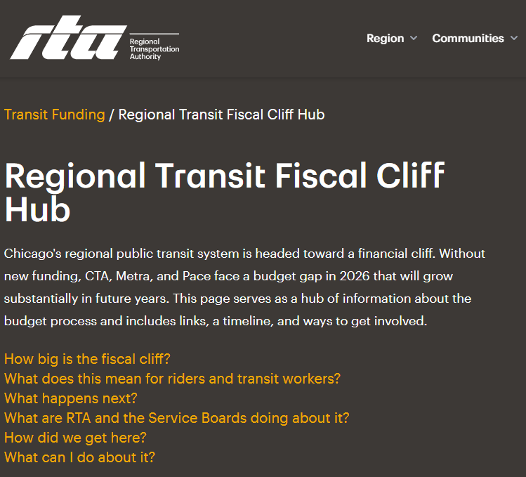
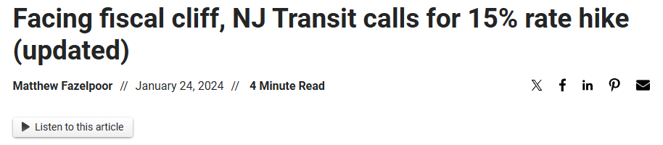
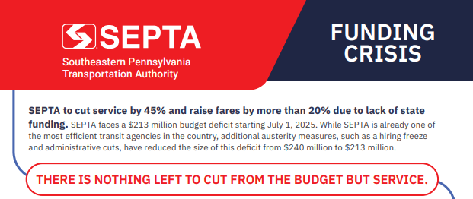
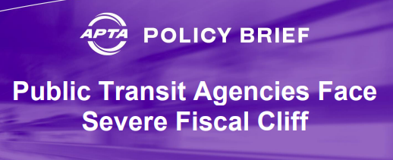
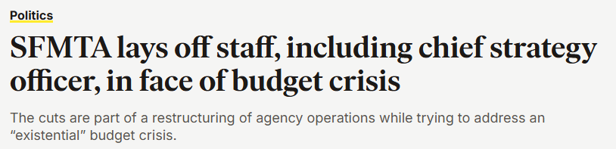

Slide 7
In May 2023, The American Public Transportation Association (APTA) surveyed 122 transit agencies.
Agencies were asked if they will experience a Fiscal Cliff in the next five fiscal years:

Slide 8
What is causing public transportation's fiscal cliff?
COVID's impact on ridership & fare revenue
Rising operating costs
Debt
Systemic underinvestment

Slide 9
What is causing The MBTA's fiscal cliff?
COVID's impact on ridership & fare revenue: The MBTA has 68% of pre-pandemic ridership. 2024 fare revenue was 62% of the revenue collected in 2019
Rising operating costs: The MBTA is currently increasing their workforce to comply with safety mandates
Debt: The MBTA pays around $400 million in debt each year, 15% of its operating costs
Systemic underinvestment: The MBTA's dedicated source of state funding, a percent of the sales tax, has significantly underperformed

Slide 10
Seek Increased State Funding
Reduce Transit Agency Costs
Seek Increased Local Funding
Seek New Dedicated Tax Revenues
Seek Other New Revenues (e.g., Advertising, Naming Rights)
Reduce Service
Shift Funds from Capital Budget to Operating Budget
Seek Increased Fares
Reduce Workforce
Most Likely
In May 2023, The American Public Transportation Association (APTA) surveyed 122 transit agencies.
Agencies were asked to rank potential responses to operating budget shortfalls:
Least Likely

Slide 11
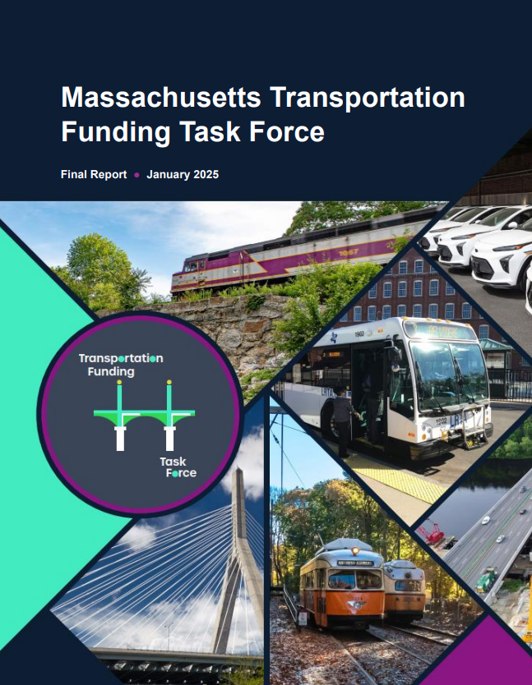
How did The MBTA respond to fiscal cliff?
The $700 million deficit for the current fiscal year was addressed when the Governor and the State Legislature signed a state budget, allocating over $400 million to the MBTA from the surplus revenue generated by the millionaires' tax
Additional increases in state assistance
$100 million in internal savings
However, as systemic problems remain, MBTA budget officials project operating budget gaps as soon as FY2028.

Slide 12
MetroBridge Project: Comparative Fiscal Study of US Public Transit Agencies
Through this partnership, Economics of the Public Sector will conduct research on the shared fiscal challenges currently facing U.S. public transit agencies, the measures taken to address these challenges, and any proposed solutions.
Researchers will ask...
What is the agency's financial outlook?
What internal actions have been taken/proposed by the agency to solve fiscal constraints?
What actions have been taken/proposed by state & federal government to address fiscal concerns at the agency?
What can the MBTA and the Commonwealth of Massachusetts learn from the funding circumstances of peer agencies?

